Slide 1
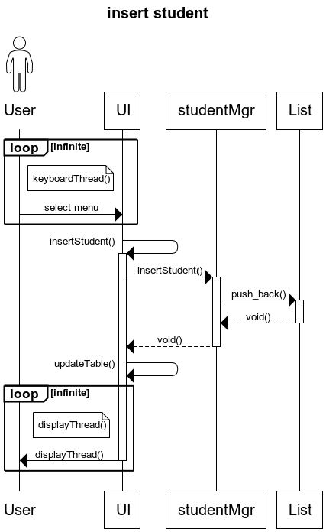
Insert Student Ver.1
title insert student
actor User
loop infinite
note left of UI
keyboardThread()
end note
User->UI: select menu
End
UI->+UI: insertStudent()
UI->+studentMgr: insertStudent()
studentMgr->+List: push_back()
List-->-studentMgr: void()
studentMgr-->-UI: void()
UI->UI: updateTable()
loop infinite
note left of UI
displayThread()
end note
UI->-User: displayThread()
end

Slide 2
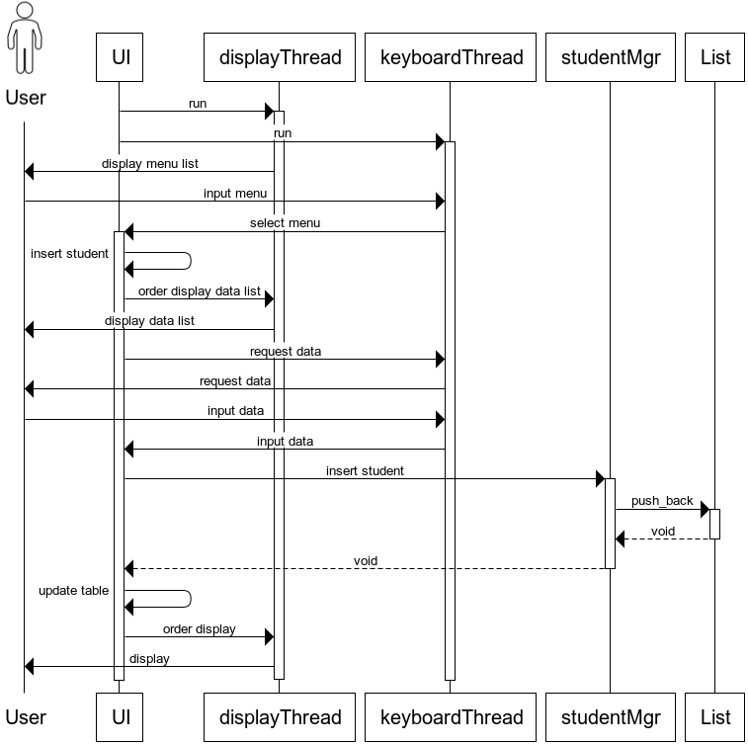
Insert Student Ver.2
title insert student
actor User
UI->+displayThread: run
UI->+keyboardThread: run
displayThread->User: display menu list
User->keyboardThread: input menu
keyboardThread->+UI: select menu
UI->UI: insert student
UI->displayThread: order display data listdisplayThread->User: display data list
UI->keyboardThread: request data
keyboardThread->User: request data
User->keyboardThread: input data
keyboardThread->UI: input data
UI->+studentMgr: insert student
studentMgr->+List: push_back
List-->-studentMgr: void
studentMgr-->-UI: void
UI->UI: update table
UI->displayThread: order display
displayThread->User: display

Slide 3
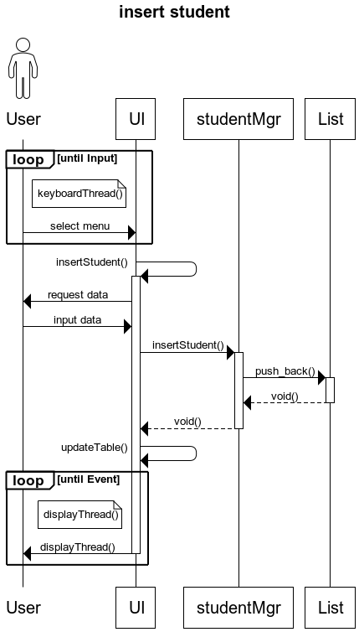
Insert Student Ver.3
title insert student
actor User
loop until Input
note left of UI
keyboardThread()
end note
User->UI: select menu
End
UI->+UI: insertStudent()
UI->User: request data
User->UI: input data
UI->+studentMgr: insertStudent()
studentMgr->+List: push_back()
List-->-studentMgr: void()
studentMgr-->-UI: void()
UI->UI: updateTable()
loop until Event
note left of UI
displayThread()
end note
UI->-User: displayThread()
end

Slide 4
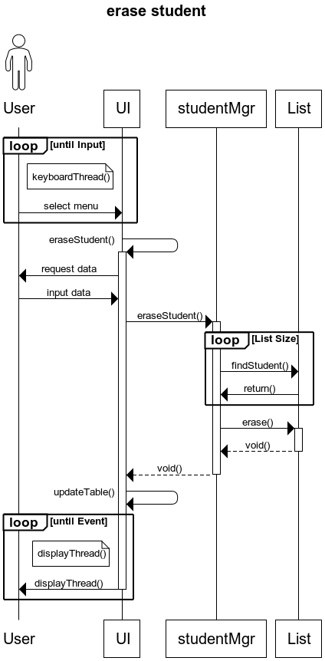
Erase Student Ver.1
title erase student
actor User
loop until Input
note left of UI
keyboardThread()
end note
User->UI: select menu
End
UI->+UI: eraseStudent()
UI->User: request data
User->UI: input data
UI->+studentMgr: eraseStudent()
loop List Size
studentMgr->List: findStudent()
List->studentMgr: return()
End
studentMgr->+List: erase()
List-->-studentMgr: void()
studentMgr-->-UI: void()
UI->UI: updateTable()
loop until Event
note left of UI
displayThread()
end note
UI->-User: displayThread()
end

Slide 5
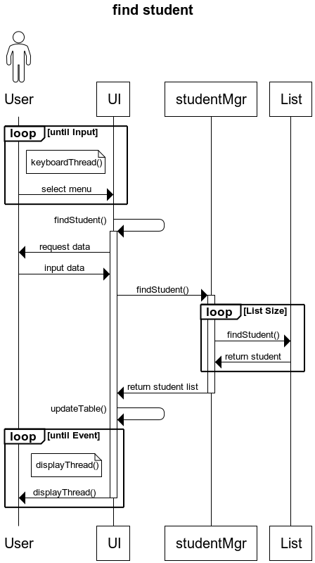
Find Student Ver.1
title find student
actor User
loop until Input
note left of UI
keyboardThread()
end note
User->UI: select menu
End
UI->+UI: findStudent()
UI->User: request data
User->UI: input data
UI->+studentMgr: findStudent()
loop List Sizes
tudentMgr->List: findStudent()
List->studentMgr: return student
End
studentMgr->-UI: return student list
UI->UI: updateTable()
loop until Event
note left of UI
displayThread()
end note
UI->-User: displayThread()
end

Slide 6
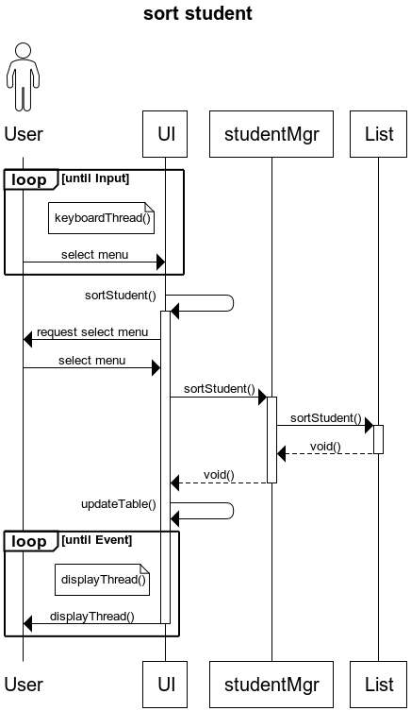
Sort Student Ver.1
title sort student
actor User
loop until Input
note left of UI
keyboardThread()
end note
User->UI: select menu
End
UI->+UI: sortStudent()
UI->User: request select menu
User->UI: select menu
UI->+studentMgr: sortStudent()
studentMgr->+List: sortStudent()
List-->-studentMgr: void()
studentMgr-->-UI: void()
UI->UI: updateTable()
loop until Event
note left of UI
displayThread()
end note
UI->-User: displayThread()
end

Slide 7
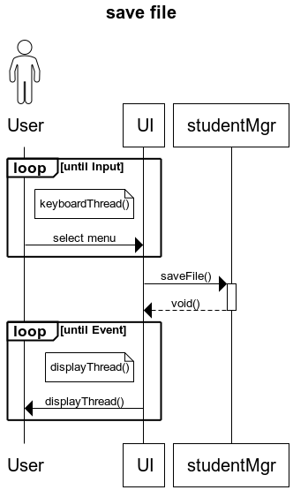
save file Ver.1
title save file
actor User
loop until Input
note left of UI
keyboardThread()
end note
User->UI: select menu
End
UI->+studentMgr: saveFile()
studentMgr-->-UI: void()
loop until Event
note left of UI
displayThread()
end note
UI->-User: displayThread()
end

Slide 8
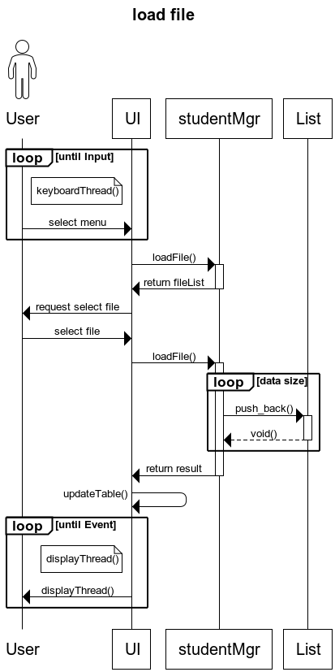
load file Ver.1
title load file
actor User
loop until Input
note left of UI
keyboardThread()
end note
User->UI: select menu
End
UI->+studentMgr: loadFile()
studentMgr->-UI: return fileList
UI->User: request select file
User->UI: select file
UI->+studentMgr: loadFile()
loop data size
studentMgr->+List: push_back()
List-->-studentMgr: void()
End
studentMgr->-UI: return result
UI->UI: updateTable()
loop until Event
note left of UI
displayThread()
end note
UI->-User: displayThread()
end

